Slide 1



Technical Presentation
Real-World Efficiency Analysis Using Asymptotic Notations
Analysis of Merge Sort Algorithm on Large Datasets
CSA0614 – Design and Analysis of Algorithm
By:
Mohan Kumar J (192424060)
Faculty:
Dr. Sairam

Slide 2


Problem Statement
Large datasets require efficient processing algorithms.
Inefficient algorithms increase execution time.
Performance depends on the input size (n).
Analyse Merge Sort using asymptotic notations.
Estimate execution growth mathematically.
Evaluate scalability for real-world applications.
Organizations process millions of records every day, such as
Student databases
Banking transactions
E-commerce products
Objective
Analyze the efficiency of Merge Sort using asymptotic notations and evaluate its performance on different input sizes.

Slide 3
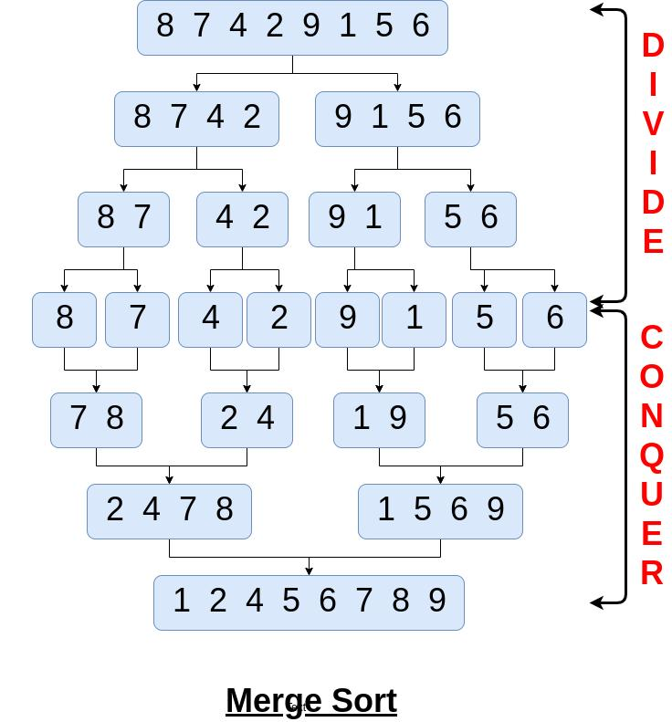
Algorithm Overview
Merge Sort
Merge Sort follows the Divide and Conquer technique.
Steps
Divide the array into two halves.
Recursively sort both halves.
Merge the sorted halves.
Continue until the complete array is sorted
Characteristics
Stable sorting algorithm
Recursive algorithm
Suitable for large datasets
Predictable performance
Efficient for external sorting
Time Complexity
O(n log n)

Slide 4
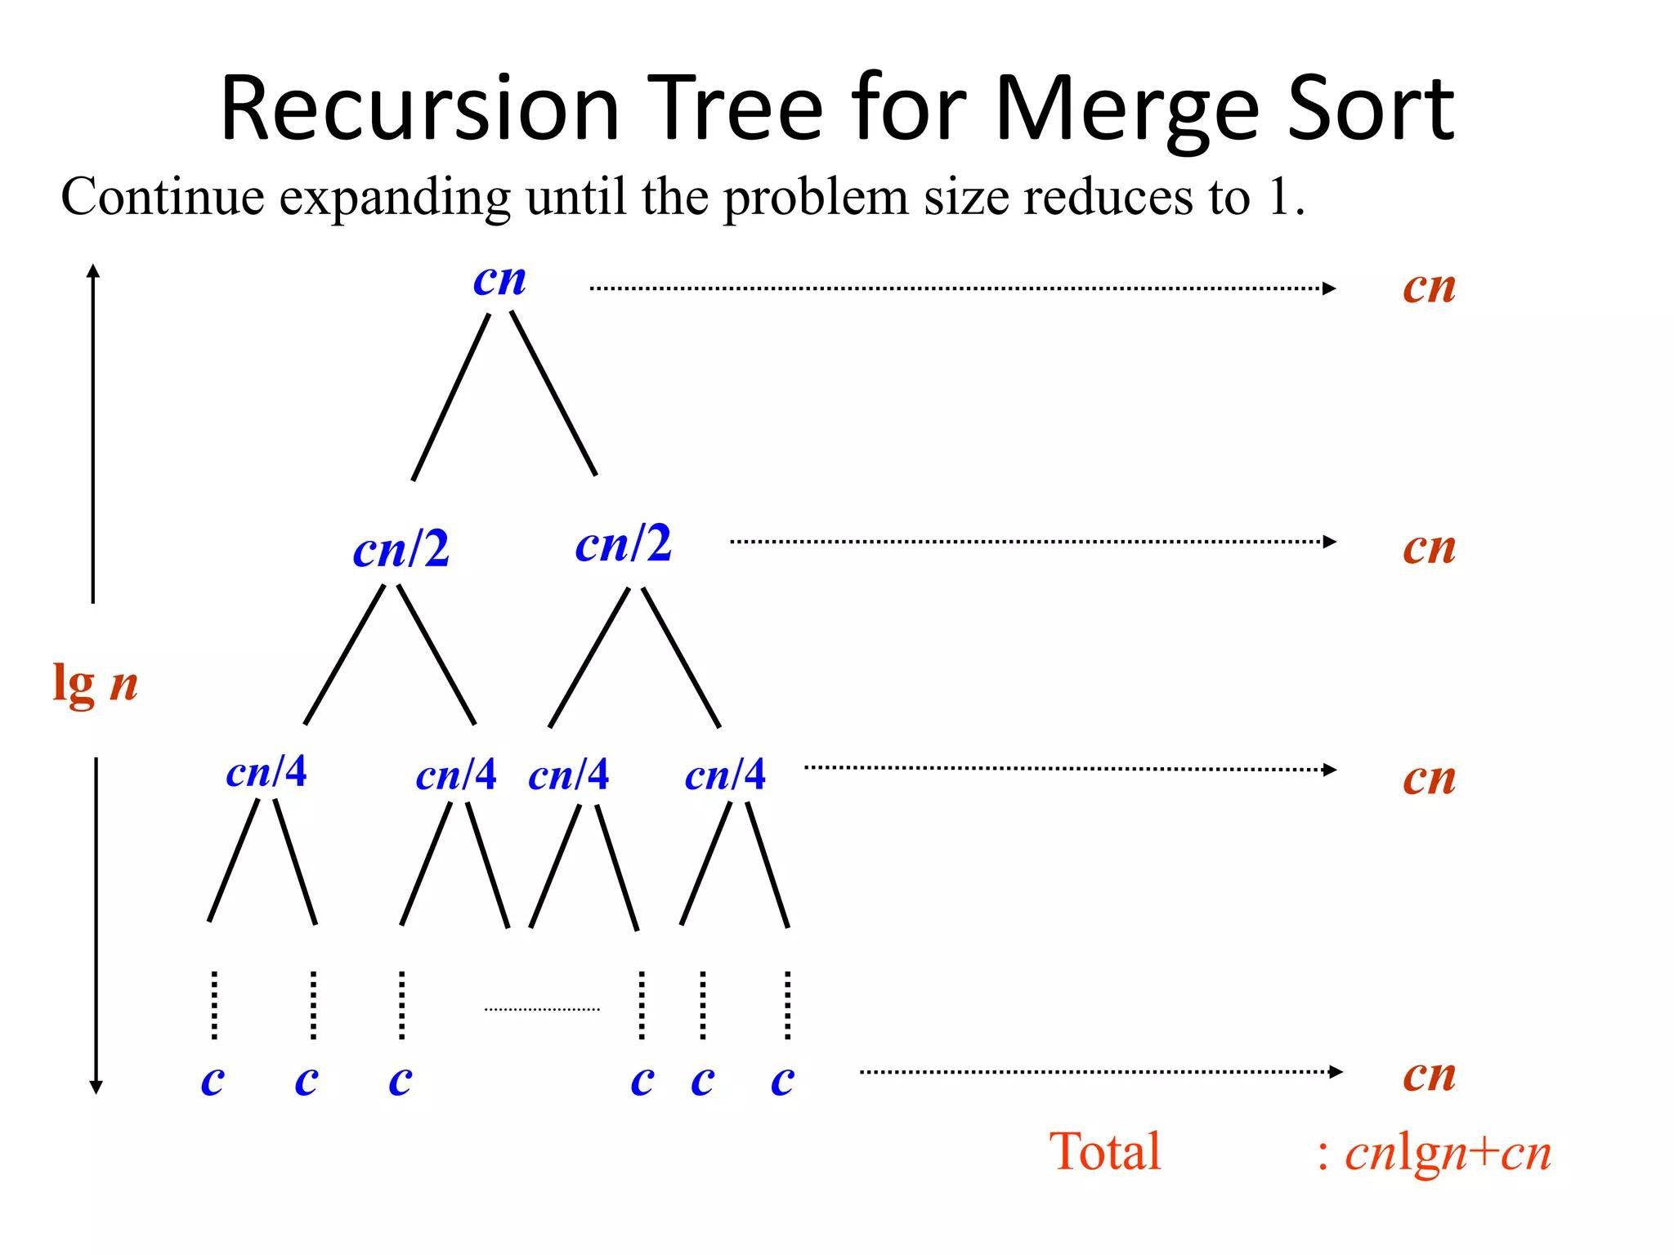
Algorithm / Pseudo Code
Merge Sort Algorithm:
Divide the array into two halves.
Recursively sort the left half.
Recursively sort the right half.
Compare elements while merging.
Place smaller elements first.
Continue until the array is fully sorted.
Pseudocode
MergeSort(A, l, r)
if l < r
mid = (l+r)/2
MergeSort(A,l,mid)
MergeSort(A,mid+1,r)
Merge(A,l,mid,r)

Slide 5
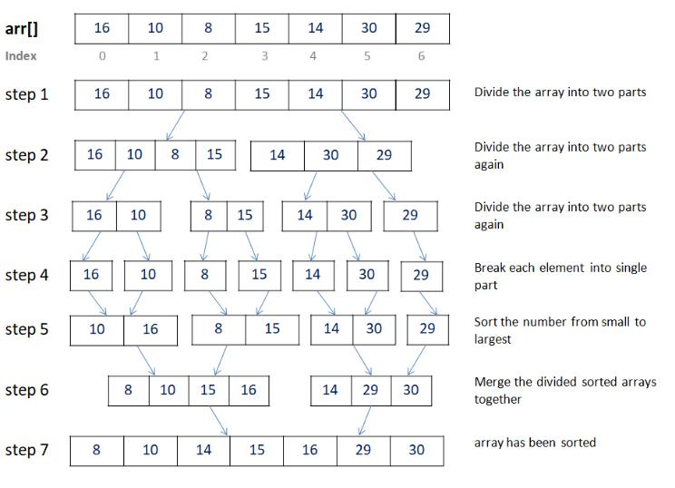
Working Example (Dry Run)
Array: arr[]= 16, 10, 8, 15, 14, 30, 29

Slide 6
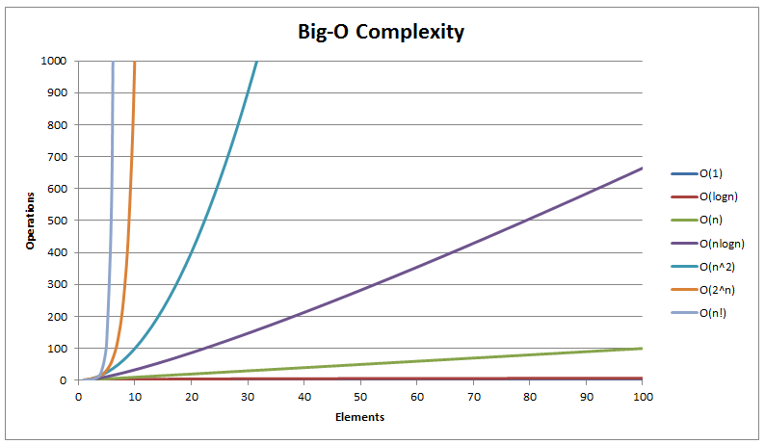
Complexity Analysis
Complexity:
Best Case: O(n log n)
Average Case: O(n log n)
Worst Case: O(n log n)
Space Complexity: O(n)
Recurrence: T(n)=2T(n/2)+n
Master Theorem: O(n log n)
Mathematical Analysis
Recurrence Relation T(n) = 2T(n/2) + n
Using Master Theorem a = 2
b = 2
f(n) = n Therefore,
T(n) = O(n log n)

Slide 7
Comparative Analysis
Algorithm | Best | Average | Worst | Stable
Bubble Sort | O(n) | O(n²) | O(n²) | Yes
Selection Sort | O(n²) | O(n²) | O(n²) | No
Insertion Sort | O(n) | O(n²) | O(n²) | Yes
Quick Sort | O(n log n) | O(n log n) | O(n²) | No
Merge Sort | O(n log n) | O(n log n) | O(n log n) | Yes
Key Points
Merge Sort gives consistent performance.
Better scalability than quadratic algorithms.
Suitable for large datasets.
Stable sorting algorithm.
Predictable execution time.
Efficient for external sorting.

Slide 8

Applications
Database Management Systems Sorting millions of records.
Search Engines Sorting indexed web pages.
Banking Systems Sorting transaction histories.
E-commerce Product listing based on price and rating.
Data Analytics Sorting large datasets before analysis.
External File Sorting
Used when data exceeds RAM capacity

Slide 9
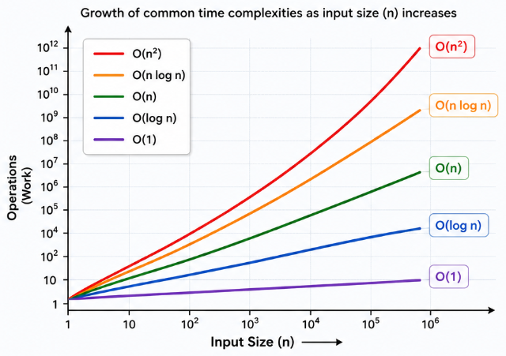
Result and Conclusion
Results
Performance follows O(n log n) growth.
Execution time increases gradually.
Efficient for large input sizes.
Uses additional memory during merging.
Better scalability than O(n²) algorithms.
Suitable for real-world large-scale systems.
Conclusion
Merge Sort efficiently processes large datasets.
Divide and Conquer improves performance.
Complexity remains O(n log n).
Asymptotic analysis predicts scalability.
Mathematical analysis validates efficiency.
Widely used in real-world applications.

Slide 10


Slide 11


THANK YOU

